Slide 1
GPS-Based Vehicle Tracking and Accelerometer-driven Crash Detection
Submitted by:
Anish Timsina THA077BEI007
Kapur Pant THA077BEI021
Saugat Neupane THA077BEI043
Sugam Khatiwada THA077BEI046
Supervised by:
Er. Kshetraphal Bohara
Department of Electronics and Computer Engineering
IOE, Thapathali Campus
March, 2024

Slide 2
Presentation Outline
Motivation
Introduction
Problem Statement & Objectives
Scope of Project
Project Applications
Methodology
Results
Discussion of Results
Future Enhancements
Conclusion
References

Slide 3
Motivation
Geographical Challenges
Significant portion of Nepal covered by hills and mountains.
Limited well-developed road infrastructures increasing safety concerns.
Post-Accident Response
Delay in notifying authorities reduces survival rate.
Vehicle Theft
Difficulty in recovering stolen vehicle with no means to track them.

Slide 4
Introduction
Raspberry Pi serves as the system's core component.
GPS module used for monitoring vehicle location.
Accelerometer sensor data is continuously transmitted to Raspberry Pi.
Deep learning model detects potential crashes using accelerometer data.
Emergency alert sent to designated contact.

Slide 5
Problem Statement & Objectives
Problem Statements
Lack of emergency services on time lead to worse accident outcome.
Lack of integrated crash detection and tracking devices.
Objectives
To design and develop a system to track and monitor vehicle’s location using GPS.
To detect accidents and alert the emergency contact as quickly as possible.

Slide 6
Scope of Project
Scopes
Real-time crash detection.
Continuous monitoring of vehicle location and movements.
Immediate notification to designated contacts.
Limitations
The system is unable to assess the severity of accidents.

Slide 7
Application
Enhances vehicle safety by enabling immediate assistance.
Live tracking for emergency vehicles.
Stolen vehicle recovery through continuous monitoring.
Tracking and management of vehicle fleets while minimizing expenses.

Slide 8
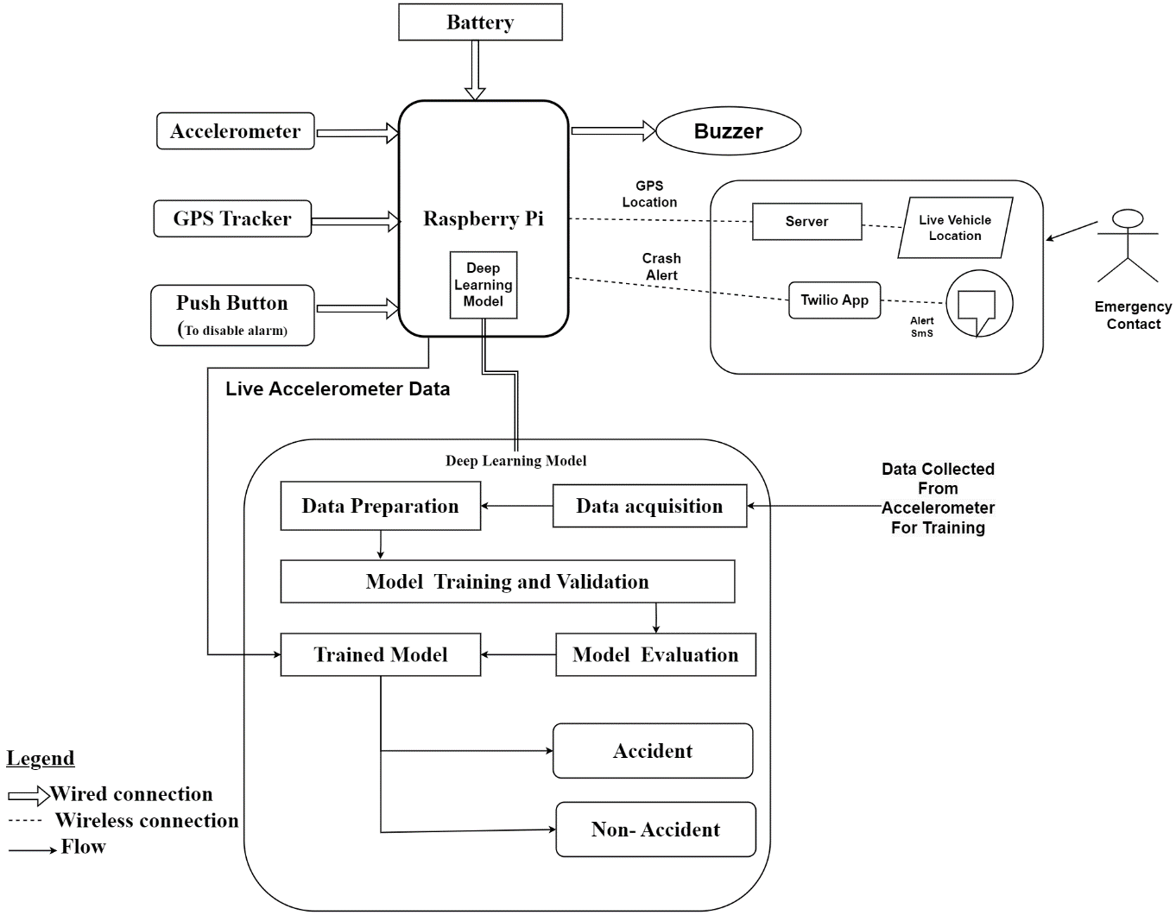
Methodology - [1] (System Block Diagram)

Slide 9
Methodology - [2] (Working Principle)
Raspberry Pi connects to accelerometer, GPS tracker, piezo buzzer and push button.
GPS tracker monitors vehicle location, transmitting data to a website for remote access.
Accelerometer continuously sends data to Raspberry Pi for crash detection.
Embedded deep learning model analyzes accelerometer data using anomaly detection algorithms.

Slide 10
Methodology - [2] (Working Principle Contd…)
Outlier data indicates potential crashes, activating an emergency buzzer.
The driver has a few seconds to respond by pressing a safety button; if pressed, no emergency message is sent.
If the button is not pressed, system sends alert message via Twilio app to emergency contact.
Current vehicle location can be viewed on the website.

Slide 11
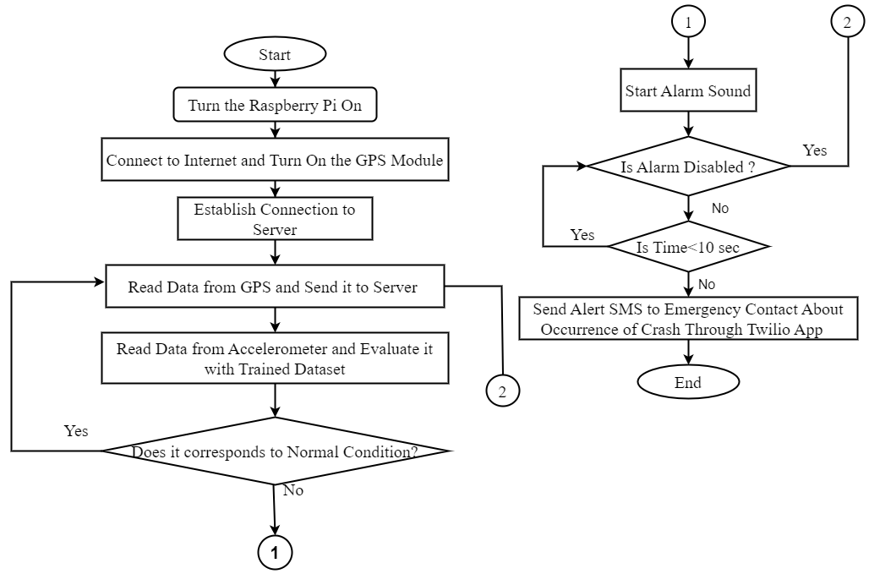
Methodology - [3] (System Flowchart)

Slide 12
Methodology – [4] (Gated Recurrent Unit(GRU))
Gated Recurrent Unit (GRU) is a type of Recurrent Neural Network (RNN) that works well with Sequential Data Analysis.
Retain important information over longer sequences without discarding relevant details from earlier parts.
This is achieved through its gating units:
Update Gate
Reset Gate

Slide 13
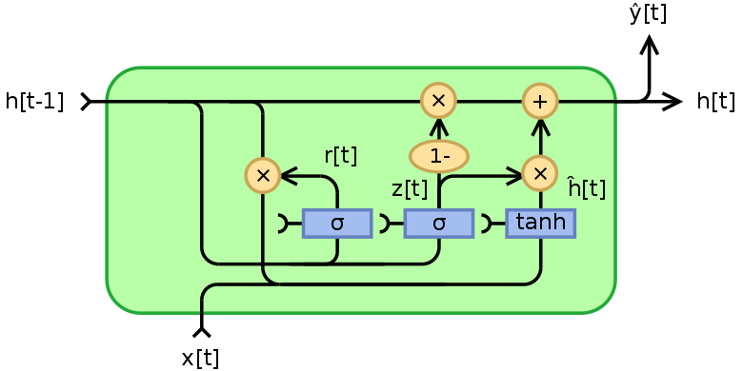
Methodology - [4] (Gated Recurrent Unit Architecture)
Output
Hidden State
Reset Gate
New Hidden State
Candidate Hidden State
Input
Update Gate

Slide 14
Methodology - [5] (Autoencoder)
An autoencoder is a type of neural network consisting of two main components:
an encoder and a decoder
Encoder compresses the input data into a lower-dimensional representation.
Decoder reconstructs the original input from the compressed representation.

Slide 15
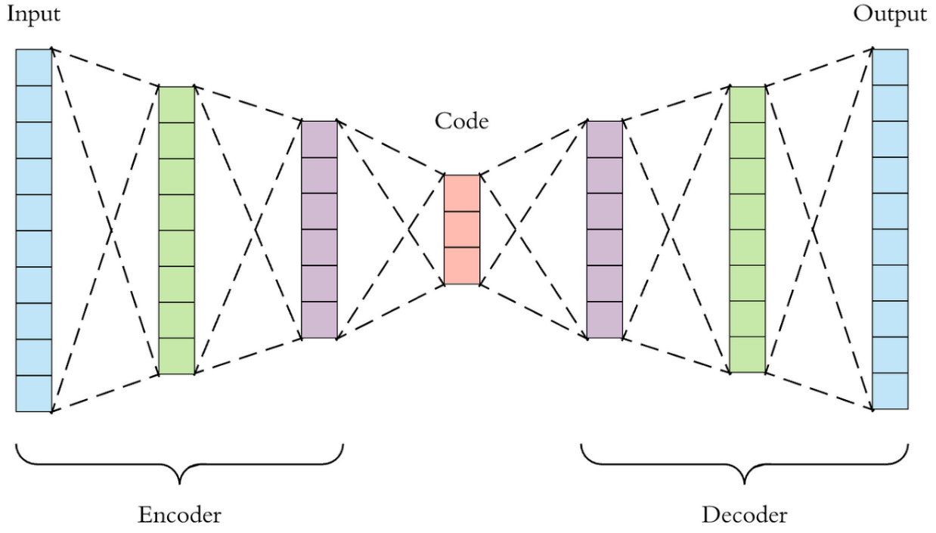
Methodology - [5] (Working of Autoencoder)

Slide 16
Methodology - [6] (GRU-Autoencoder : For Crash Detection)
Specified input, encoding, decoding, and output layers.
Trained the model to reconstruct input data while minimizing reconstruction error.
Model's performance was assessed using a separate testing dataset.
With a threshold error of 3 established, Model was trained to detect outlier data in real time.
Classify as an accident when the error exceeds the threshold.

Slide 17
Methodology - [7] (Hardware Requirement)
Raspberry Pi 4 Model B
MPU 6050 Sensor
NEO-7M GPS Module
Battery
Piezo Buzzer
Push button
R/C Car

Slide 18
Methodology - [8] (Software Requirement)
Twilio
Cloud communication platform for automatically sending alert SMS to the emergency contacts.
Visual Studio Code
Open-source code editor
Jupyter Notebook
Interactive Data Science Environment
Library Packages
TensorFlow, Keras, Matplotlib, Pandas, Sklearn, Numpy, Flask

Slide 19
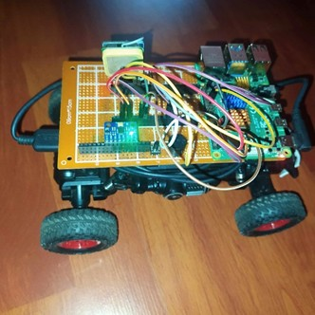
Methodology - [9] (Dataset Collection)
Data was collected of accelerometer during Normal condition.
R/C car was driven normally including braking, turning, reversing.
44,723 instances of data were collected for training and testing.
Each instance in the dataset scaled using standard scaling.

Slide 20
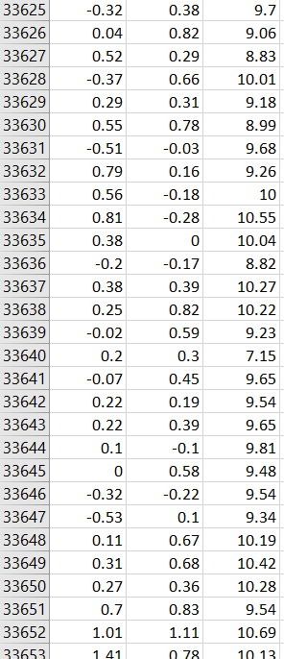
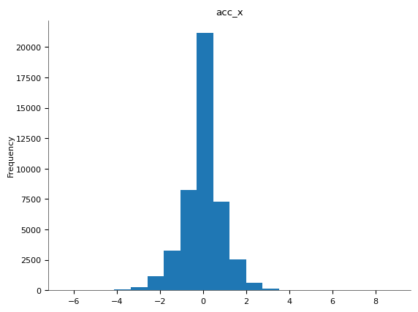
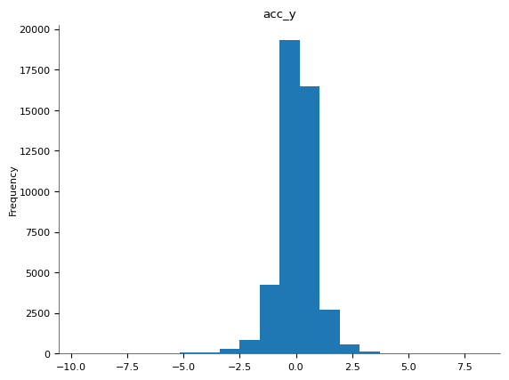
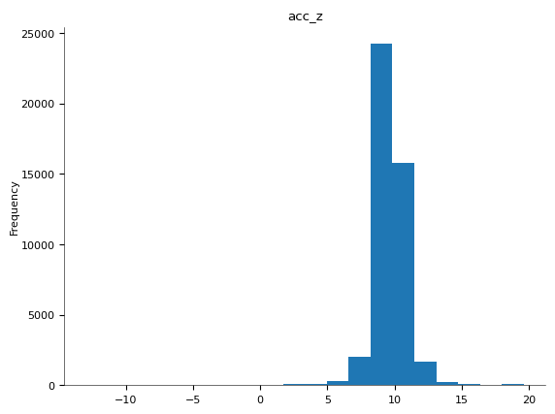
Methodology - [10] (Dataset Visualization)
acc_x acc_y acc_z

Slide 21
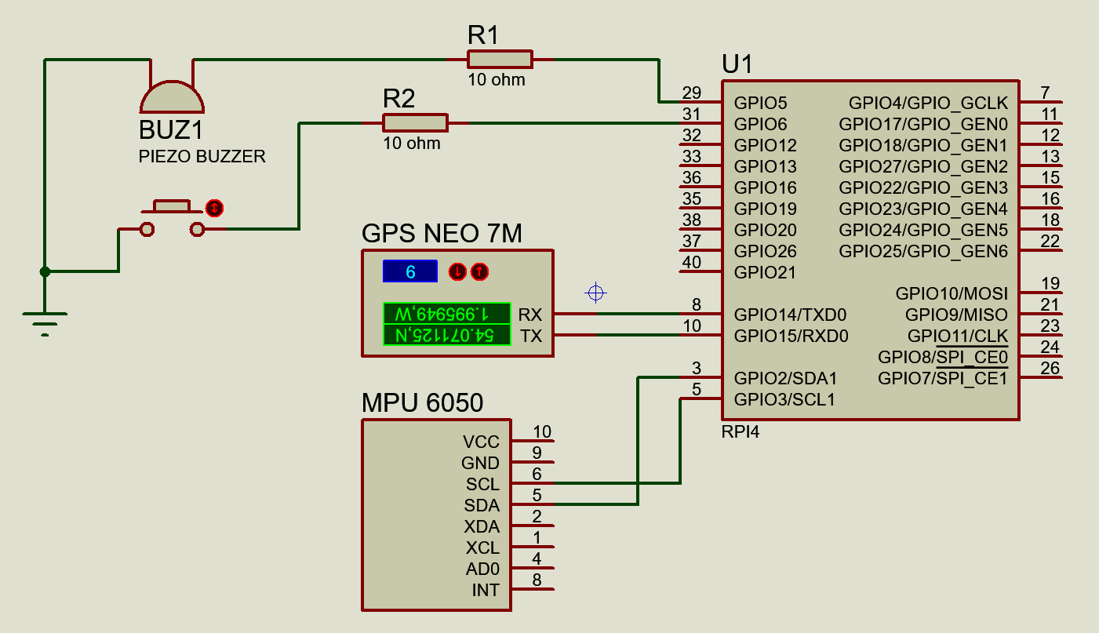
Methodology-[11] Schematic Diagram

Slide 22
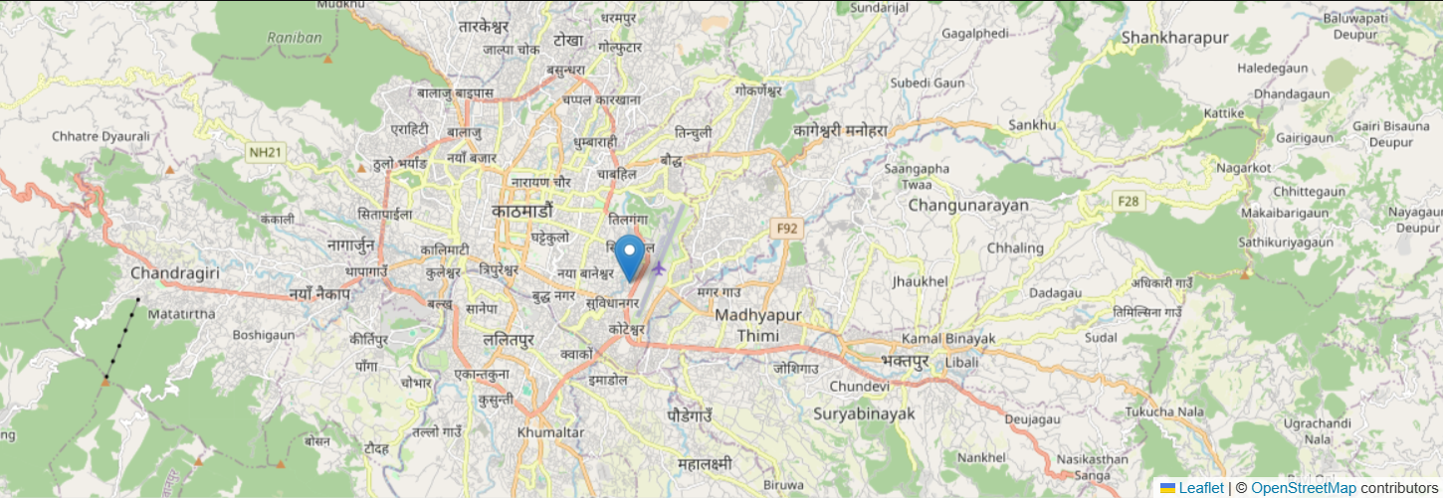
Result-[1] Live Location
Real-time GPS tracking system with IoT integration.
A website interface for location monitoring.

Slide 23
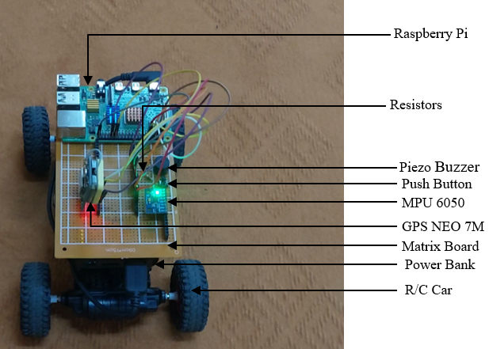
Result-[2] Hardware Setup
Hardware Setup for Vehicle Tracking and Crash Detection.
Components have been soldered in the matrix board and placed on top of R/C car.

Slide 24
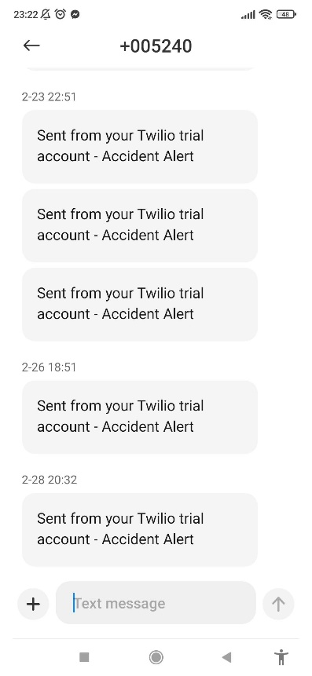
Result-[3] Alert SMS
When push button is not pressed, Alert SMS is sent to Emergency Contact.

Slide 25
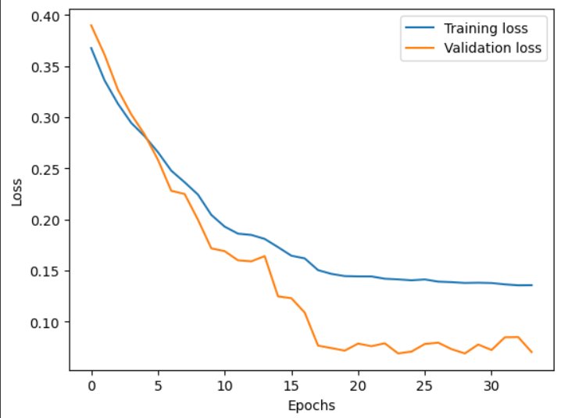
Result-[4] Loss Curve
Validation loss curve met Training loss at about 4 epochs.
Early Stopping Callback stopped the model training at 33 epochs (no improvement in validation loss over five epochs).

Slide 26
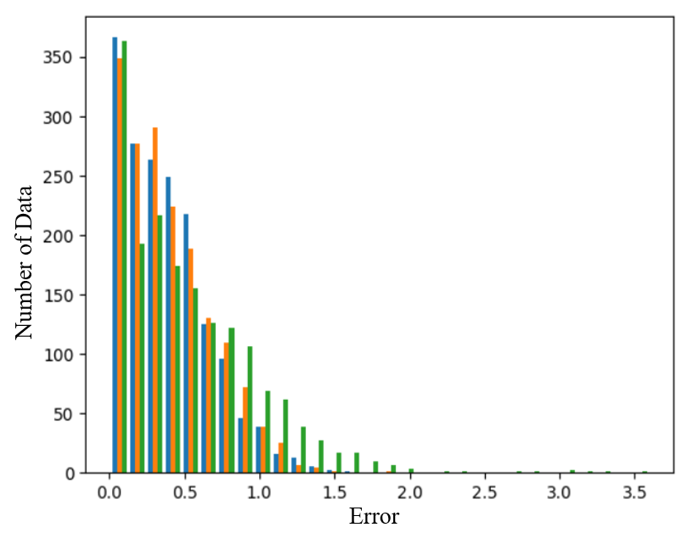
Result-[5] Reconstruction Error in Validation Data
Aside figure shows reconstruction error in validation dataset.
1700 data was collected by driving the RC car for validation.

Slide 27
Result-[6] Confusion Matrix
Constructed at various threshold values:1, 2, 2.5, 3, 4, and 5.
Generated based on the number of instances for both non-accidents and accidents.
Evaluated using a sample size of 50 instances for both accidents and non-accidents.

Slide 28
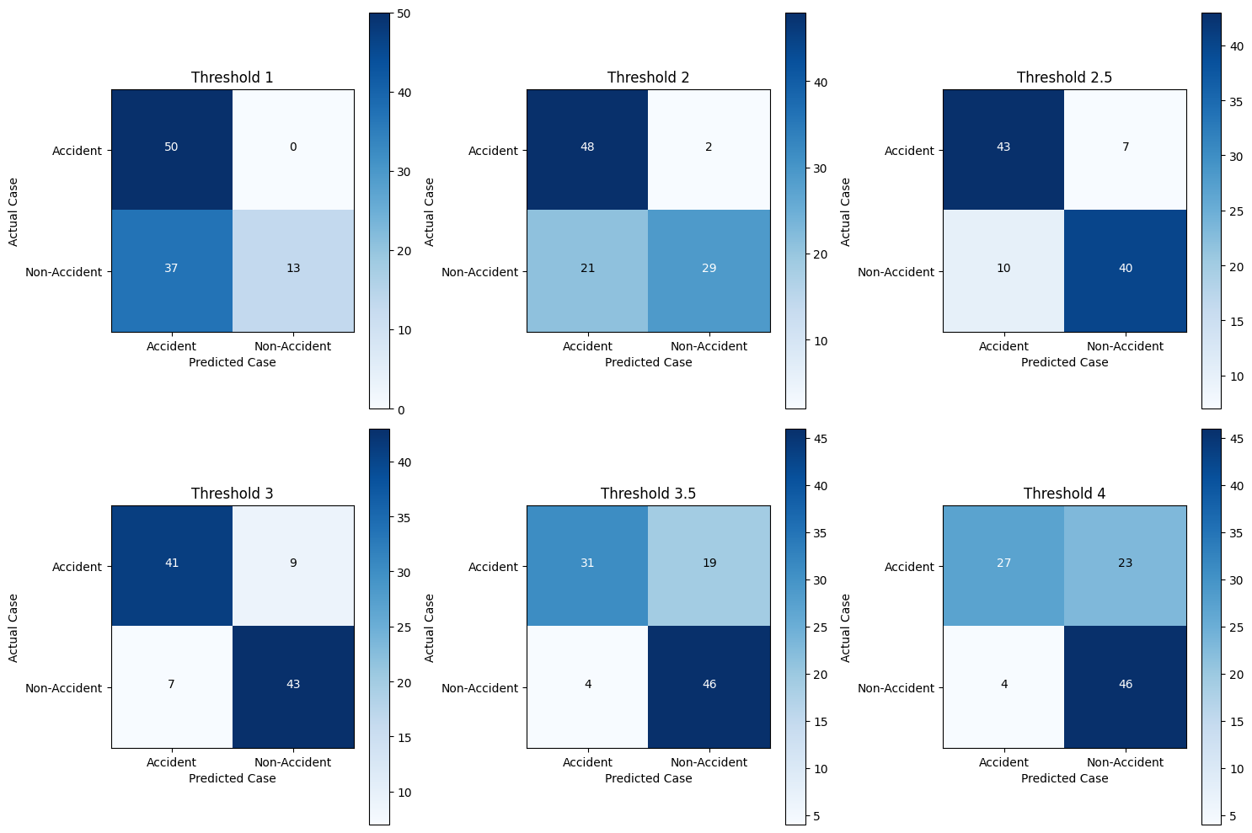
Result-[6] (Contd…Confusion Matrix)

Slide 29
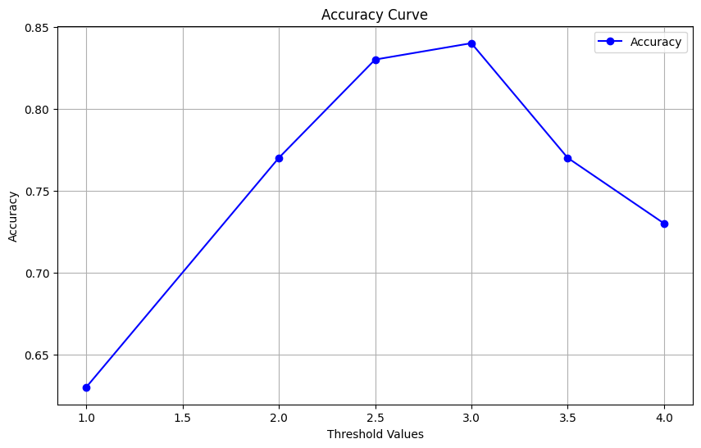
Result-[7] Accuracy Curve
Accuracy was tested for various Threshold value from 1.0 to 4.0.

Slide 30
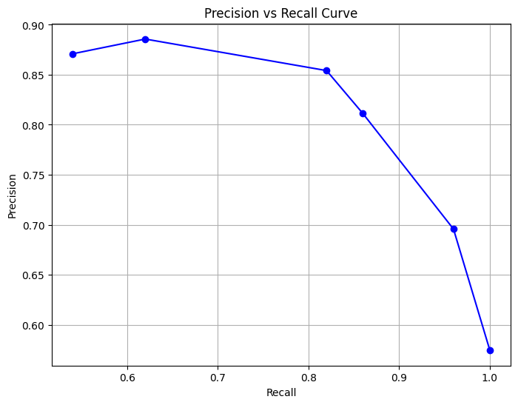
Result-[8] Precision Vs Recall
Precision-Recall curve was generated for six threshold values: 1.0, 2.0, 2.5, 3.0, 3.5, and 4.0.

Slide 31
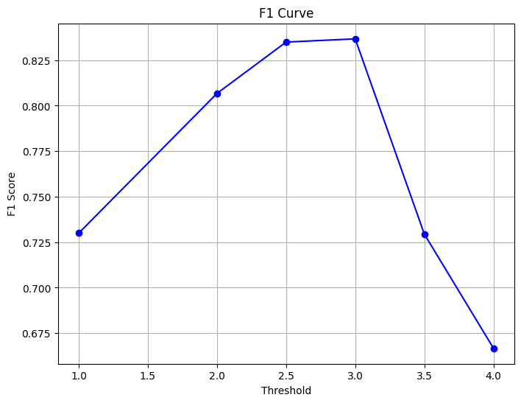
Result-[9] F1 Score
F1 Curve was generated by plotting F1 score at different threshold values from 1.0 to 4.0.

Slide 32
Discussion of Results
Crash Detection Performance
F1 score of 0.834 was obtained at threshold error 2.5.
F1 score of 0.836 was obtained at threshold error 3, which was the highest.
High false positive with threshold less than 2.5.
High false negative with threshold more than 3.
Some false positive and false negative at error 2.5 and 3 also, possibly due to hardware error (accelerometer data).

Slide 33
Future Enhancements
Dataset Collection from Real Vehicle
To enhance real-world applicability, it's essential to collect data from actual vehicles .
To gather data under various conditions, including sudden braking, lane changes, bumps, and other scenarios.
Severity Classification
Developing methodologies to classify the severity of crashes.
Done by considering factors such as vehicle deformation, impact force, and the severity of injuries sustained.

Slide 34
Conclusion
Project has successfully achieved both its objectives:
Vehicle Tracking and
Crash Detection
Relies on the Raspberry Pi as its core component.
Monitors the vehicle's location
Send data from GPS to Raspberry Pi and from Raspberry Pi to server.
Accelerometer sensor transmits its readings to the Raspberry Pi
Abnormal data suggests a crash, a buzzer alarm is triggered through a deep learning algorithm.
To apply this system in real-life scenarios, data collection from the original vehicle is necessary.

Slide 35
References
S.M. Savaresi, D. Selmanaj and M. Corno, "Accelerometer-based Data-driven Hazard Detection and Classification Accelerometer-based Data-driven Hazard Detection and Classification," in 2014 European Control Conference (ECC), Strasbourg, France, 2014.
Luca Kubin, Tommaso Bianconcini, Douglas Coimbra de Andrade, Matteo Simoncini, Leonardo Laccari, and Francesco Sambo, "Deep Crash Detection From Vehicular Sensor Data With Multimodal Self-Supervision," IEEE Transactions on Intelligent Transportation Systems, vol. 23, 2022.
Jae Gyeong Choi, Chan Woo Kong, Gyeongho Kim, Sunghoon Lim, "Car crash detection using ensemble deep learning and multimodal data from dashboard cameras," Expert Systems with Applications, vol. 183, 2021.
Roohullah Fazli Wahid, Sikandar Ali, Irshad Ahmed Abbasi, Samad Baseer, and Habib Ullah Khan, "Accident Detection in Autonomous Vehicles Using Modified Restricted Boltzmann Machine".

Slide 36
References(Contd…)
Hanif Hakimi Azlan, Suriana Salimin, "Vehicle Accident Detection System using Accelerometer," Evolution in Electrical and Electronic Engineering Vol. 4No. 1(2023), vol. 4, 2023.
M. Farahani, "Anomaly Detection on Gas Turbine Time-series’ Data Using Deep LSTM-Autoencoder," Umeå University, 2020.
Kukjin Choi, Jihun Yi. Changhwa Park, and Sungroh Yoon, "Deep Learning for Anomaly Detection in Time-Series Data: Review, Analysis, and Guidelines," IEEE Access, vol. 9, 2021.
Jaroslav Kopčan, Ondrej Škvarek, and Martin Klimo, "Anomaly detection using Autoencoders and Deep Convolution Generative Adversarial Networks," Transportation Research Procedia, vol. 55, pp. 1296-1303, 2021.
V. Mosin, M. Staron, Y. Tarakanov and D. Durisic, "Comparing autoencoder‑based approaches for anomaly detection," SN Applied Sciences, vol. 4, no. 334, 2022.

